Slide 1
Machine Learning
Unit I
Prepare by
S.Hemalatha
Assistant Professor(Sr.G)

Slide 2
Assume a Fully Automated home:
After returning back to home from work and directly go to bed .AI of your house looks at you and analyses everything abt you by using the sensors around you.
Light go dark , Air conditioner will be adjusted to the temp of your body needs
Next morning, need to back to work, AI sets everything of your morning necessities ie water is set to optimal temp to take bath, news or musics will be played based on ur mood based on sentiment analysis alg..
Cab is booked in time to go for work.
Everything is becoming reality ever so slowely but its going in right direction.

Slide 3
How all this happens?
Everything bez of AI.
What is AI?
Intelligence in machines.
It is an Artificial thing that can mimic the things that our human does(human intelligence).
1956, AI term has been coined (John McCarthy together with Alan Turing, Marvin Minsky, Allen Newell, and Herbert A. Simon.)
Intelligence:
the ability to understand, learn and think.
Capacity of understanding, self-awareness, Learning, Emotional knowledge, planning, Creativity and Problem solving.
One of the characteristics of human is “to learn”

Slide 4
Humans can learn from past experience and
Machines follow instructions given by humans.
Is it possible to make the machines to learn from the past experience?
Yes, we can …that is with the help of machine learning.
Then what is machine Learning?
It is a subset of AI that helps us to achieve one particular goal to teach
so if we are able to teach the machine to learn, then we are one step closer in reaching our goal of AI that mimic the human.
For computers, past experience has name called data. (learning from experience data).
Machine learns from data.

Slide 5
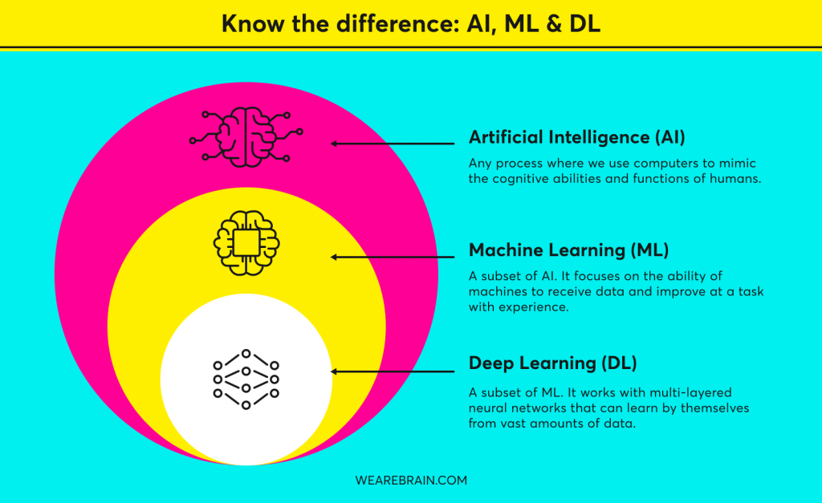
v

Slide 6
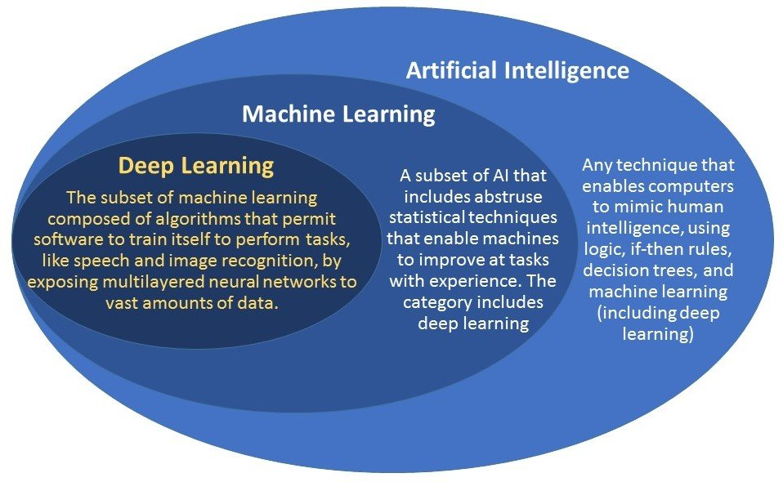

Slide 7
AI/ML/DL/DS
AI:
enables the machine to think. without human intervention, machine can take its own decision.
Finally our goal is developing AI applications. self driving car is a best example.
Developing app which uses ML/DL will be called an AI app.
ML:
subset of AI. It provides us statistical tools to explore(understand )the data.
Three different approach:
Supervised (past labeled data and can do prediction of data)
Unsupervised ( no labeled data. Solve by clustering tech. based on the similarity of data, it will group the data
Reinforcement (semi supervised) some part may be labeled and some new data may not be labeled). So model will learn slowely based on the past data).
DL: subset of ML. this helps machine to learn the things how our human brain learns. Multi neural network architecture. Basic is to mimic human brain (ANN(numerical data can be solved), CNN(images input), RNN(time series kind of data), Transfer Learning
AI is an umbrella under which other two comes in.
DS:
Try to apply all these above techniques, statistics, probability, linear algebra, differential calculus)

Slide 8
Mostly in ML, we use numerical and statistical data to achieve AI. Example of ML is product recommendation engine(a component of ML), Amazon Alexa – speech recognition, netflix- movie recommendation, google traffic predcition etc
And DL is the subset of ML. DL comes in where ML fails.
What is the difference between ML and deep learning?
Machine learning is about computers being able to think and act with less human intervention;
deep learning is about computers learning to think using structures modeled on the human brain

Slide 9
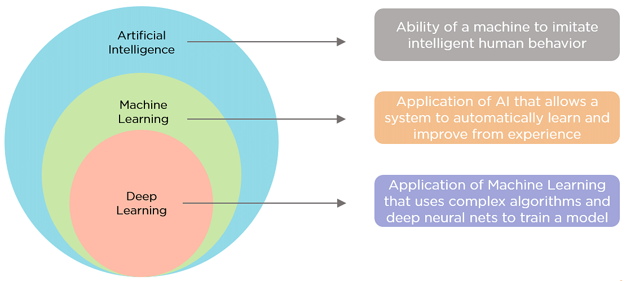

Slide 10
Why now?
Flood of available data (bez of advent of internet)
Increasing computational power.
Increasing support from industries.
Growing progress in available alg and theory developed by researchers.

Slide 11
History
1940s -the first manually operated computer system, ENIAC (Electronic Numerical Integrator and Computer), was invented.
At that time the word “computer” was being used as a name for a human with intensive numerical computation capabilities, so, ENIAC was called a numerical computing machine!
from the beginning the idea was to build a machine able to emulate human thinking and learning.
In the 1950s, first computer game program (Samuel's Checkers-Playing System) - able to beat the checkers world champion. This program helped checkers players a lot in improving their skills!.
The term machine learning was coined in 1959 by Arthur Samuel, an American IBMer and pioneer in the field of computer gaming and artificial intelligence.
Around the same time, Frank Rosenblatt invented the Perceptron which was a very, very simple classifier but when it was combined in large numbers, in a network, it became a powerful monster.
Then we see several years of stagnation of the neural network field due to its difficulties in solving certain problems.
machine learning became very famous in the 1990s because of statistics.
As a highlight, IBM’s Deep Blue system beat the world champion of chess, the grand-master Garry Kasparov. 1997

Slide 12
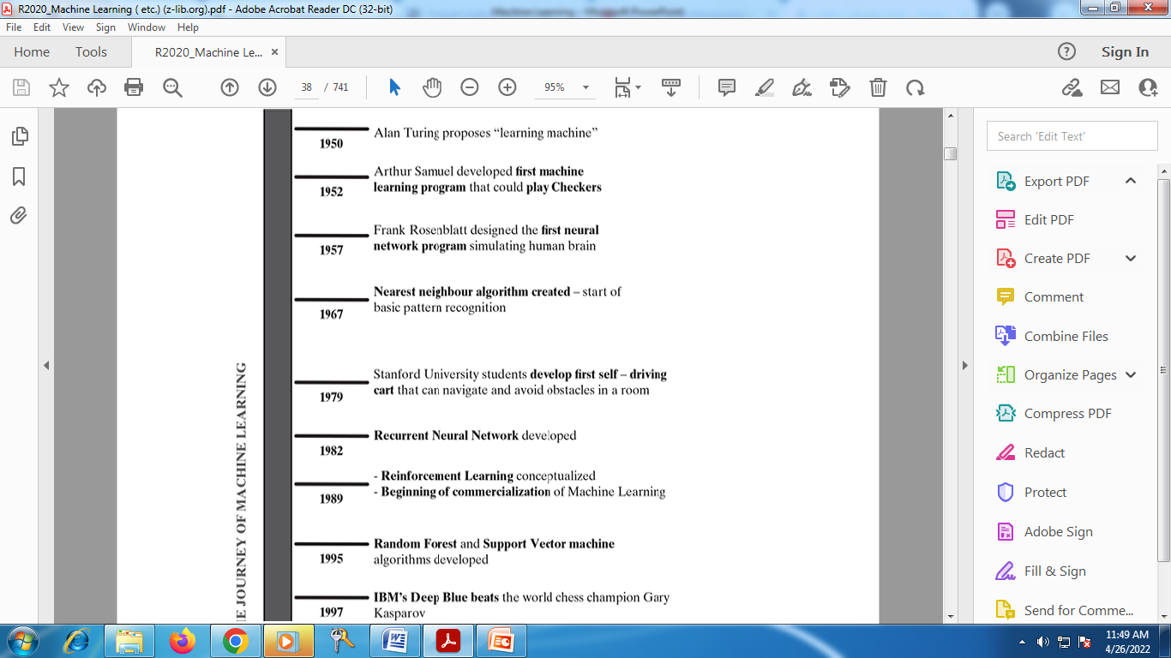
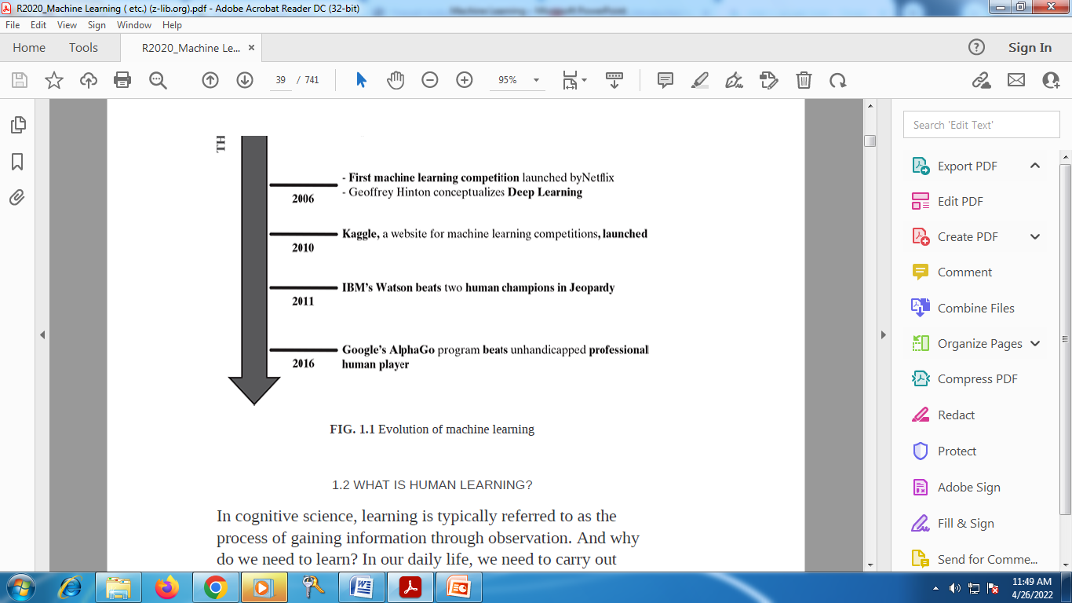
Evolution of ML

Slide 13
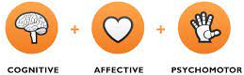
WHAT IS HUMAN LEARNING?
The Three Types of Learning: (KSA)
Cognitive: mental skills (Knowledge)
Affective: growth in feelings or emotional areas (Attitude)
Psychomotor: manual or physical skills (Skills)
In cognitive science, learning is typically referred to as the process of gaining information through observation.
TYPES OF HUMAN LEARNING:
(1) either somebody who is an expert in the subject directly teaches us - learning directly under expert guidance,
(2) we build our own notion indirectly based on what we have learnt from the expert in the past - learning guided by knowledge gained from experts
(3) we do it ourselves, may be after multiple attempts, some being unsuccessful - self-learning.

Slide 14
Learning under expert guidance:
An infant may inculcate certain traits and characteristics, learning straight from its guardians.
Learning guided by knowledge gained from experts:
learning also happens with the knowledge which has been imparted by teacher or mentor at some point of time in some other form/context.
For example, a baby can group together all objects of same colour even if his parents have not specifically taught him to do so. He is able to do so because at some point of time or other his parents have told him which colour is blue, which is red, which is green, etc.
there is no direct learning.
Learning by self:
humans are left to learn on their own. A classic example is a baby learning to walk through obstacles.
A lot of things need to be learnt only from mistakes made in the past. We tend to form a check list on things that we should do, and things that we should not do, based on our experiences.

Slide 15
What is machine learning?
Do machines really learn?
If so, how do they learn?
Which problem can we consider as a well-posed learning problem? What are the important features that are required to well-define a learning problem?
Definition of machine learning:
Machine learning is an application of Artificial Intelligence where we give machines access to data and let them use that data to learn for themselves. It's basically getting a computer to perform a task without explicitly being programmed to do so.

Slide 16
Tom M. Mitchell, Professor of Machine Learning Department, School of Computer Science, Carnegie Mellon University has defined machine learning as
‘A computer program is said to learn from experience E with respect to some class of tasks T and performance measure P, if its performance at tasks in T, as measured by P, improves with experience E.’
ML brings Statistics and computer science together to enable the computer to do the task without human intervention.
Once feeding the images of object, it recognize the objects through its statistical patterns.
https://www.youtube.com/watch?v=f_uwKZIAeM0 How machine learns
https://www.youtube.com/watch?v=jxihC6ucRQQ ML in 5 minutes

Slide 17
How machine learns ?
Taking dataset and divided into two parts : training data (80%)and testing data(20%).
Training data -> trains ML algorithm ->build a model.
Test data -> model -> predicting (evaluated for accuracy).
What is dataset and database?
Dataset is a collection of data in the form of numerical, images, videos etc
Example :
the test scores of each student in a particular class is a data set.
Database:
Set of organized data and accessed by DBMS.

Slide 18
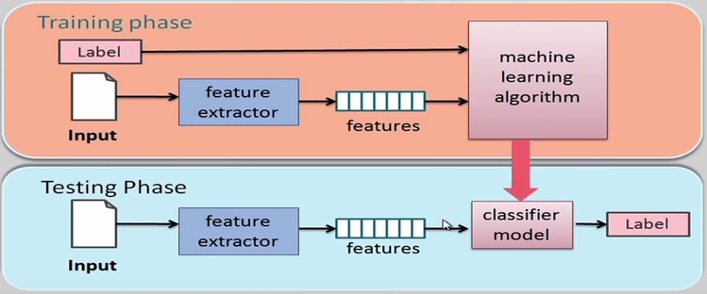

Slide 19
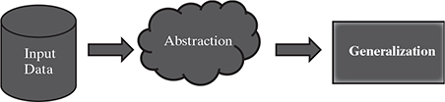
How do machines learn?
The basic machine learning process can be divided into three parts.
1. Data Input: Past data or information is utilized as a basis for future decision-making
2. Abstraction: The input data is represented in a broader way through the underlying algorithm
3. Generalization: The abstracted representation is generalized to form a framework for making decisions
FIG. 1.2 Process of machine learning

Slide 20
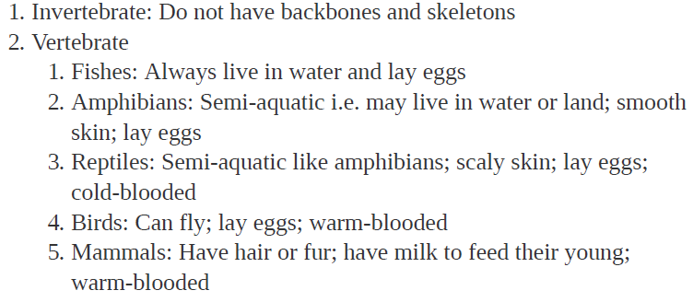
Example:
Students preparing for exam:
If Syllabus is simple, then easy to memorize
If vast, its difficult to memorize.
So, a good option is to figure out the key points or ideas amongst a vast pool of knowledge.
This helps in creating an outline of topics and a conceptual mapping of those outlined topics with the entire knowledge pool.

Slide 21
The first part of machine learning process is abstraction i.e. abstract the knowledge which comes as input data in the form of a model. However, this abstraction process, or more popularly training the model, is just one part of machine learning.
The other key part is to tune up the abstracted knowledge to a form which can be used to take future decisions. This is achieved as a part of generalization.
This part is quite difficult to achieve. This is because the model is trained based on a finite set of data, which may possess a limited set of characteristics.
But when we want to apply the model to take decision on a set of unknown data, usually termed as test data, we may encounter two problems:
1. The trained model is aligned with the training data too much, hence
may not portray the actual trend.
2. The test data possess certain characteristics apparently unknown to the
training data.

Slide 22
Well-posed learning problem
The framework involves answering three questions:
1. What is the problem? (eg text prompting)
2. Why does the problem need to be solved? –motivation of the problem or requirements
3. How to solve the problem? Step-by-step solution

Slide 23
Terminologies of Machine Learning
Model – A model is a specific representation learned from data by applying some machine learning algorithm. A model is also called a hypothesis.
Feature – A feature is an individual measurable property of the data. A set of numeric features can be conveniently described by a feature vector. Feature vectors are fed as input to the model. For example, in order to predict a fruit, there may be features like color, smell, taste, etc.(variables/attributes/factors/parameters)
Target (Label) – A target variable or label is the value to be predicted by our model. For the fruit example discussed in the feature section, the label with each set of input would be the name of the fruit like apple, orange, banana, etc.
Training – The idea is to give a set of inputs(features) and it’s expected outputs(labels), so after training, we will have a model (hypothesis) that will then map new data to one of the categories trained on.
Prediction – Once our model is ready, it can be fed a set of inputs to which it will provide a predicted output(label).

Slide 24
Types of machine Learning
1.Supervised learning – Also called predictive learning. A machine predicts the class of unknown objects based on prior class-related information of similar objects.
2. Unsupervised learning – Also called descriptive learning. A machine finds patterns in unknown objects by grouping similar objects together.
3. Reinforcement learning – A machine learns to act on its own to achieve the given goals

Slide 25
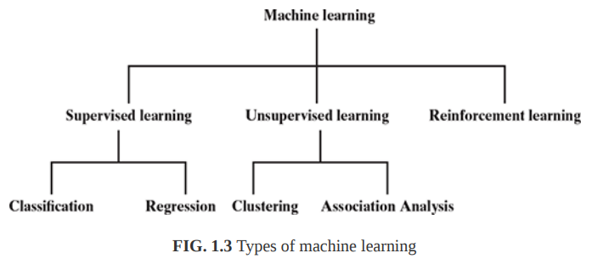

Slide 26
Supervised Learning
Oversee or direct a certain activity and make sure its done correctly.
Machine learns under guidance.
Giving labeled input to train.
Teach machines using labeled data.
Based on the training data, the machine builds a predictive model that can be used on test data to assign a label for each record in the test data

Slide 27
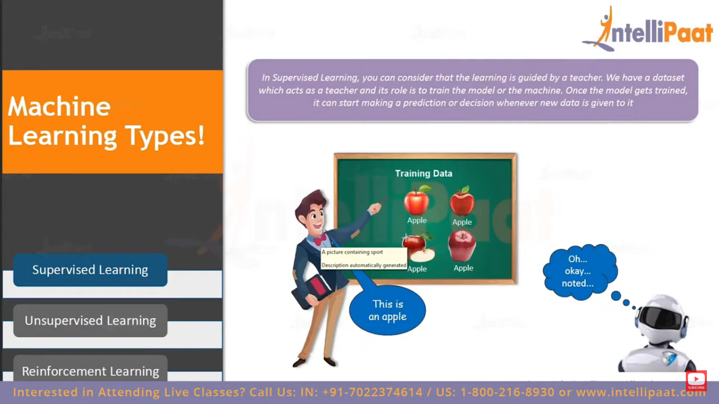
Supervised

Slide 28
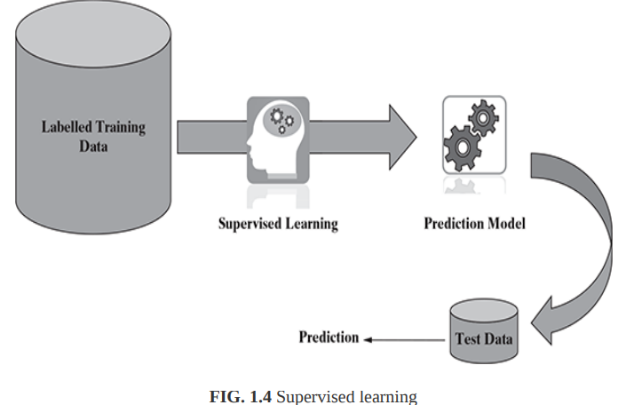
Supervised

Slide 29
Training phase is well defined and very explicit.
Here, the only thing the algorithm needs to do is mapping the input to the output.
Training data act as a teacher or guide here.
The main aim of the supervised learning is forecast an outcome.
Popular algorithm:
Linear regression, logistic regression, SVM, KNN,RF
Applications:
Forecasting sales profit, Risk evaluation
https://www.youtube.com/watch?v=xtOg44r6dsE

Slide 30
Types of problems in supervised
Classification
Regression
Classification:
classification is Predicting a label or a class.
Example: Apple and not an apple, Spam and non-spam mails (contains two classes, so classification alg). Having only 2 possibilities (ip address, domain reputation, etc)
Regression:
regression is predicting a continuous quantity (continuous variable is infinite number of possibilities).
Predictive analysis used to predict continuous variable
Example :Person’s weight. 50kg,50.1kg,50.7kg etc. number of possibilities for weights are limitless.
Price of a stock over some period of time.

Slide 31
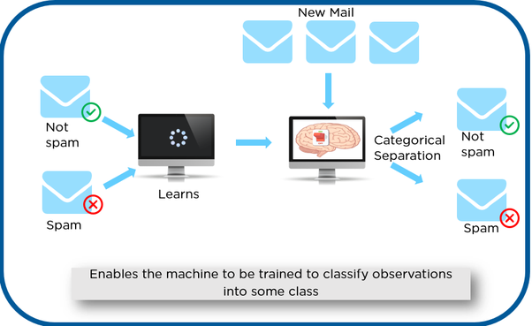

Slide 32
Examples of supervised learning:
Predicting the results of a game
Predicting whether a tumour is malignant or benign
Predicting the price of domains like real estate, stocks, etc.
Classifying texts such as classifying a set of emails as spam or non-spam.
Consider 2 and 3, In 2nd case, we are trying to predict which category or class an unknown data belongs to.
whereas in the 3rd case, we are trying to predict an absolute value and not a class.
When we are trying to predict a categorical or nominal variable, the problem is known as a classification problem.
Whereas when we are trying to predict a real-valued variable, the problem falls under the category of regression.
Supervised machine learning is as good as the data used to train it. If the training data is of poor quality, the prediction will also be far from being precise.

Slide 33
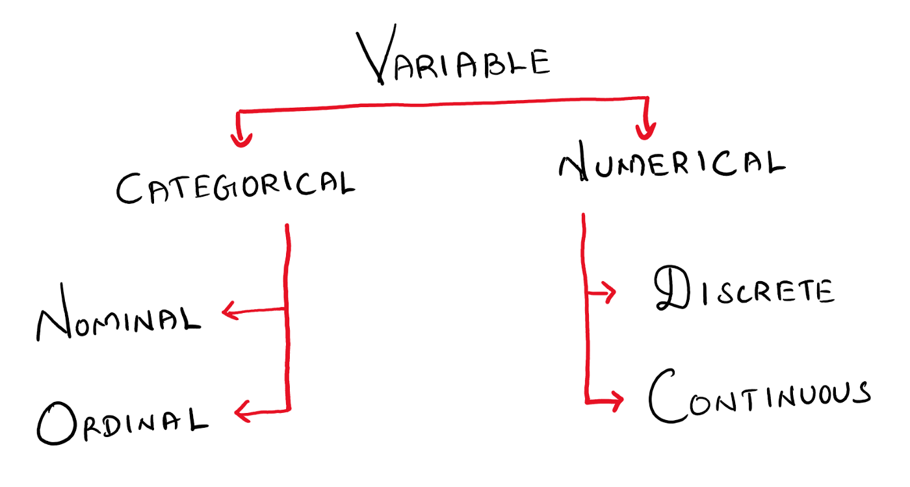
we need to know about variables in our dataset to decide the which Ml model to be used. labeled categories without any quantitative value
quantitative data can be measured and the measures of values or counts are expressed as numbers
qualitative data is divided into categories or groups
Discrete data can only take certain values. Eg.no.of students in a class
Nominal scale is a naming scale, where variables are simply “named” or labeled, with no specific order. Eg hair color
Ordinal scale has all its variables in a specific order, beyond just naming them. Eg ranking,rating
can take any value(within a range).eg weight, time

Slide 34
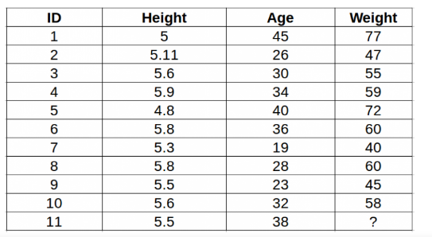
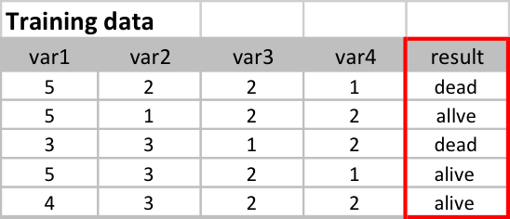
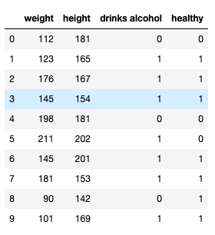
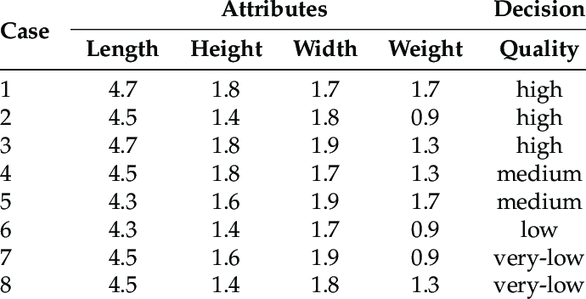

Slide 35
Classification
Since the target objective is to assign a class label, this type of problem as classification problem.
There are number of popular machine learning algorithms which help in solving classification problems. To name a few, Naïve Bayes, Decision tree, and k-Nearest Neighbour algorithms are adopted by many machine learning practitioners.
A critical classification problem in context of banking domain is identifying potential fraudulent transactions.
classification is a type of supervised learning where a target feature, which is of type categorical, is predicted for test data based on the information imparted by training data.
The target categorical feature is known as class.
Some typical classification problems include:
Image classification
Prediction of disease
Win–loss prediction of games
Prediction of natural calamity like earthquake, flood, etc.
Recognition of handwriting

Slide 36
Regression
Typical applications of regression can be seen in
Demand forecasting in retails
Price prediction in real estate
Weather forecast
Skill demand forecast in job market.
Sales prediction for managers

Slide 37
Supervised:
Study a bank credit dataset and make a decision about whether to approve the loan of an applicant based on his profile.
(cust’s account balance, purpose, credit amount, savings in dataset)
KNN
To establish a mathematical equation for distance as a function of speed, so you can use it to predict the distance when only the speed of the car is known.
Linear Regression (basically used to predict continuous quantities) – predict the distance that a car can travel based on its speed

Slide 38
Unsupervised
Act without anyone’s supervision or guidance .
Data is not labeled.
Only unlabeled data will be given as input.
And wont say the machine where to go, the system has to understand itself from the given input data.
It did this by finding pattern in the data.
Eg finally it forms two groups. one has cats and other has dogs.
Here machine wont add labels to the output.
It will understand how cats look and group or cluster them into one group.
Machine has to figureout the dataset given and it has to find/discover the hidden patterns and trends in the data in order to make predictions about the output.

Slide 39
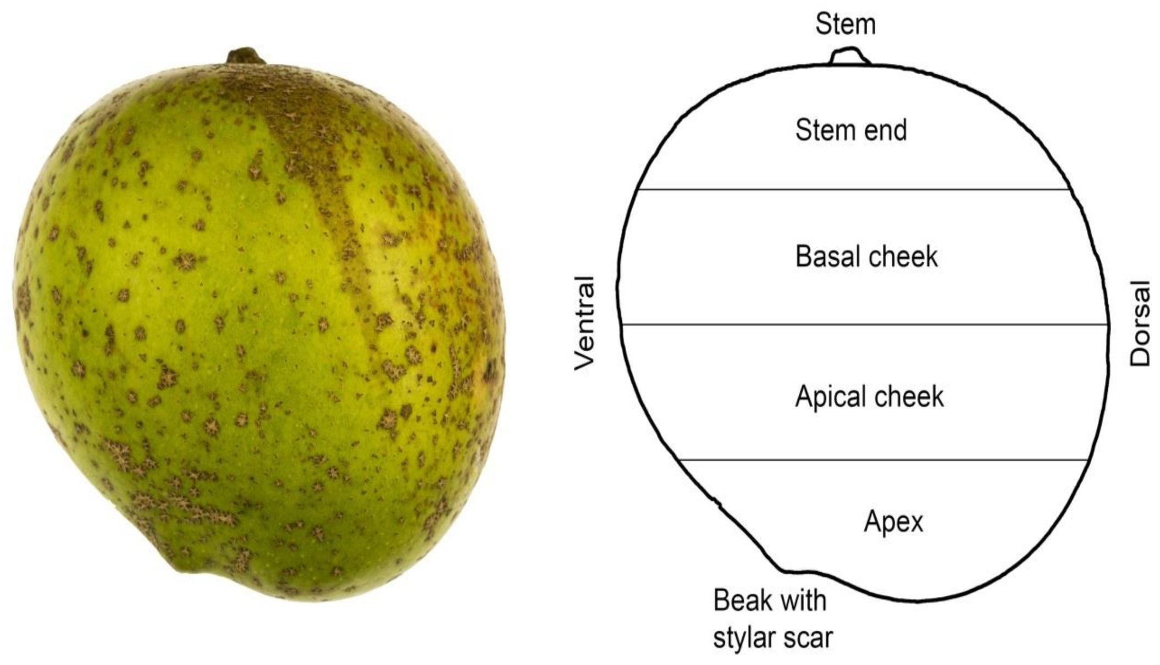

Slide 40
Types of problems
Association and
Clustering.
Association:
Association is discovering patterns in data and finding co-occurrences
Finding the Items that frequently co-occur.
Ex. relationship between bread and jam. People who buy bread will mostly tend to buy jam.
Clustering and anomaly detection:
Targeted marketing : list of customer and information about them and need to cluster them based on their similarity.(interest and intent).
Anomaly detection is detecting unusual activities like credit card fraud.

Slide 41
Here training phase is big, bex the machine is only given the input data and its has to figure out the output on its own.
So no supervisor or mentor here.
Its all about discovering patterns and extracting useful insights. Trends and association in the data.
Therefore, unsupervised learning is often termed as descriptive model and the process of unsupervised learning is referred as pattern discovery or knowledge discovery.
Popular algorithms:
K-means, Apriori, C-means
Applications:
customer segmentation.
Recommendation, anamoly detection

Slide 42
To cluster a set of movies as either good or average based on their social media out reach.
One cluster contains popular movie and other contains non-popular movies based on likes on social media.
To perform market basket analysis by finding association between items bought at the grocery store. (apriori)
If person buy bread and butter together, then there may be an association between these two items.
From past transaction data in a grocery store, it may be observed that most of the customers who have bought item A, have also bought item B and item C or at least one of them. This means that there is a strong association of the event ‘purchase of item A’ with the event ‘purchase of item B’, or ‘purchase of item C’.

Slide 43
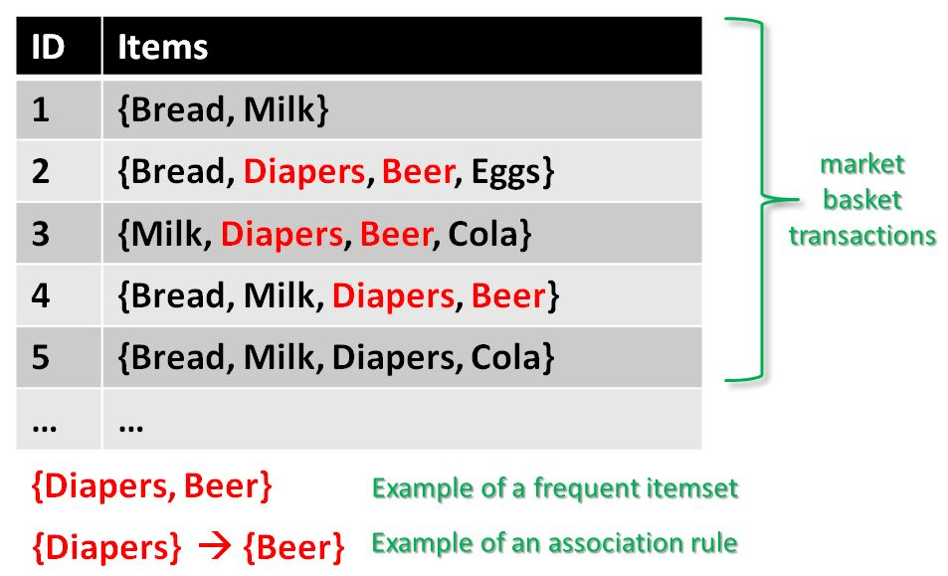
Market basket analysis

Slide 44
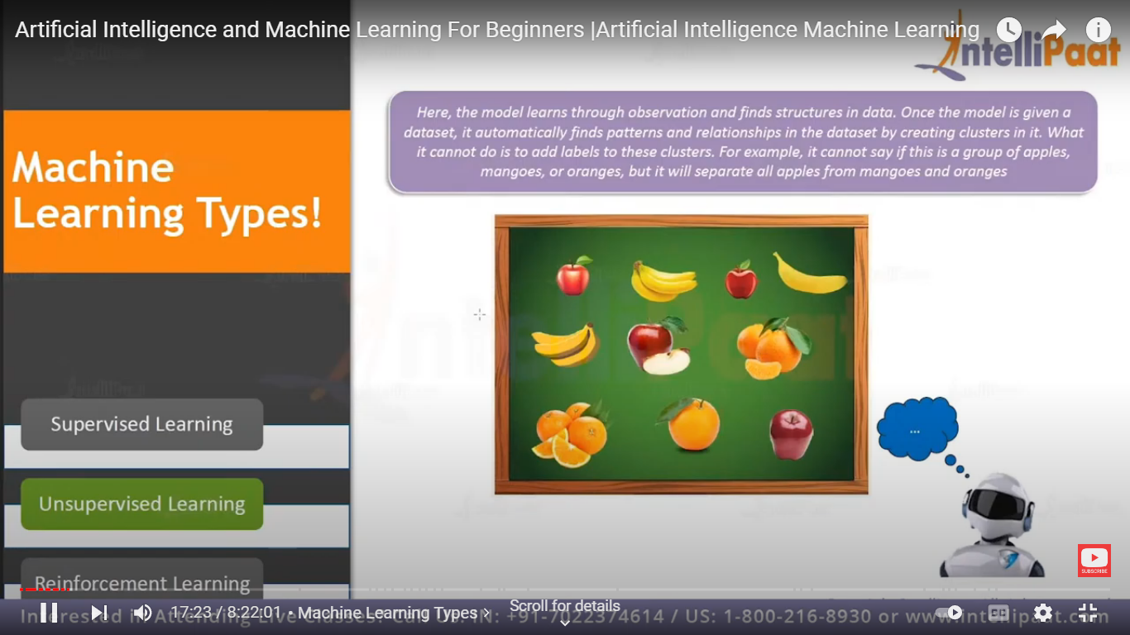
Unsupervised

Slide 45
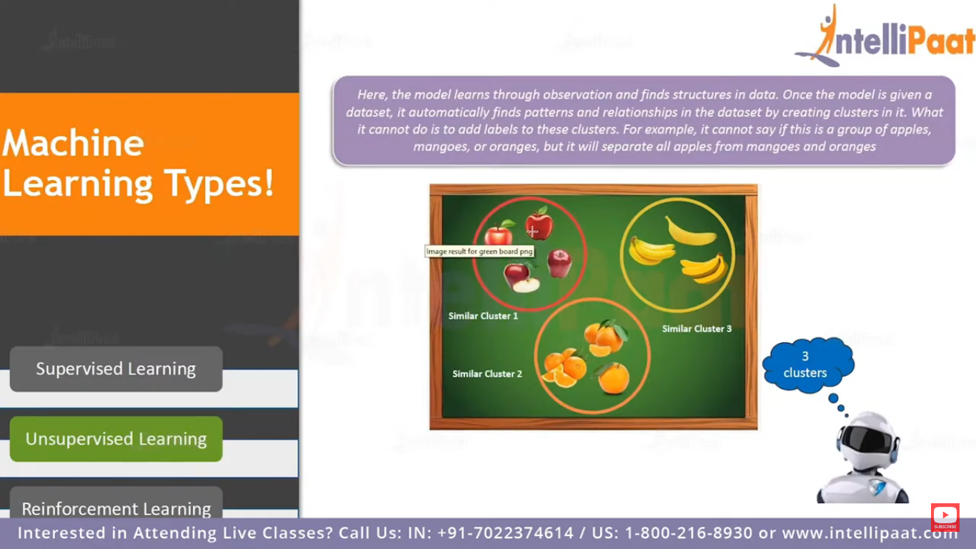
Unsupervised

Slide 46
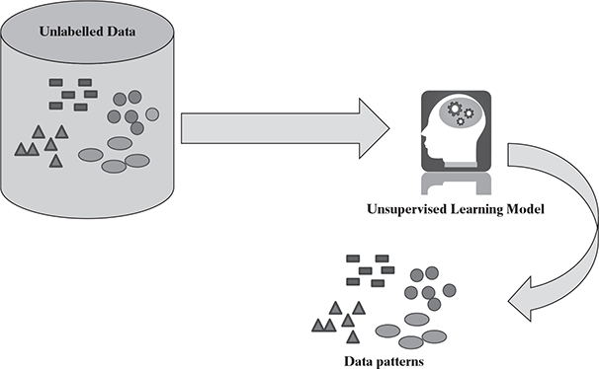

Slide 47
Reinforcement
Establish or encourage a pattern or behavior.
Ex. Dropped in an Isolated island.
Hit and trial or trial and error.
First, experience and learn from the experience.
In Reinforcement Learning (RL), agents are trained on a reward and punishment mechanism. The agent is rewarded for correct moves and punished for the wrong ones. In doing so, the agent tries to minimize wrong moves and maximize the right ones.
Agent is put in an unknown environment, so that agent can explore the environment by taking actions and transition from one state to other so that it can get maximum rewards.
no predefined data will be given to the machine. Inputs depends on the action taken by the agent. These actions are recorded as matrices, so that it serves as a memory to the agent. Just agent explodes the environment it will collect data which was then being used to get the output.

Slide 48
Here the agent is like a child, as it doesnot know about the environment, the agent too does not know about the environment and only after exploring the environemnt, it starts learning. Learns from mistakes it makes(basically from experiences)
Explored recently.
Algorithms:
Q-Learning, SARSA (state action reward state action alg)
Applications:
Self driving car, games- alphago game, intelligent games

Slide 49
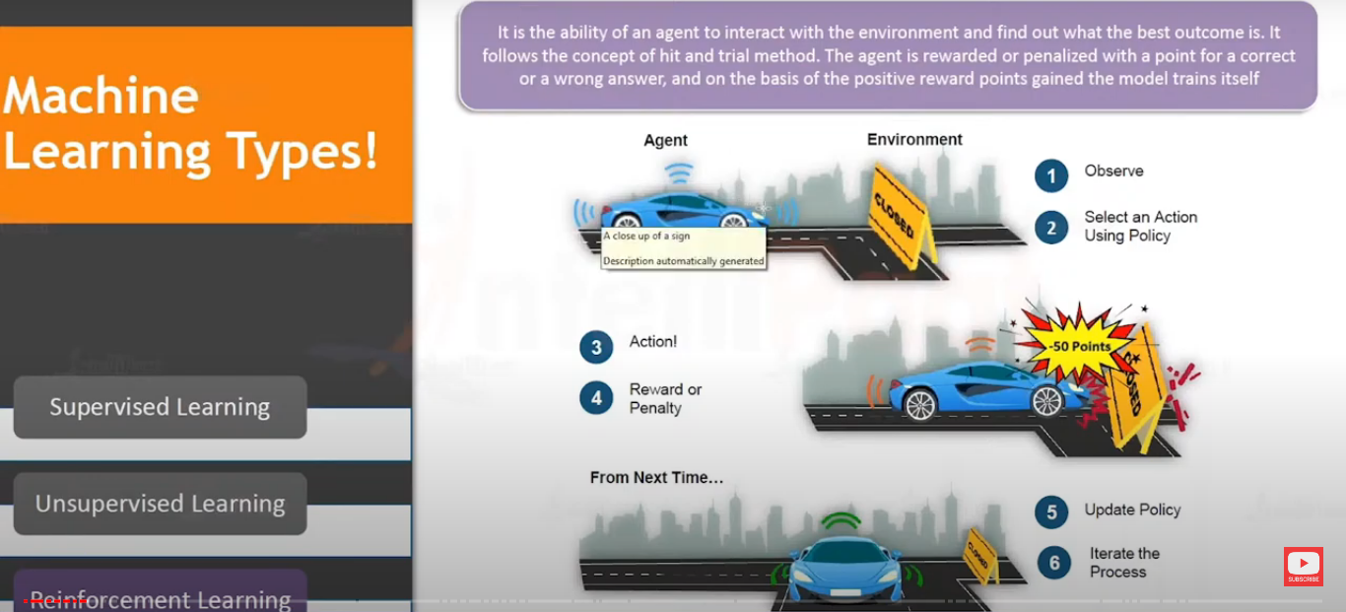
reinforcement

Slide 50

A reinforcement learning algorithm, or agent, learns by interacting with its environment. The agent receives rewards by performing correctly and penalties for performing incorrectly. The agent learns without intervention from a human by maximizing its reward and minimizing its penalty. It is a type of dynamic programming that trains algorithms using a system of reward and punishment.

Slide 51
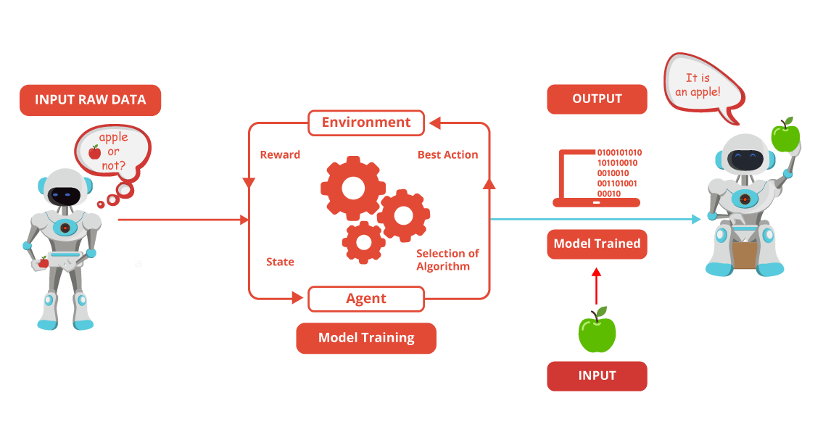

Slide 52
No predefined data, so the whole reinforcement learning process itself a training and testing phase.
So need to learn on its own and its starts by exploring and collecting data.
Try out all possible actions to learn about its environment and to get maximum rewards.

Slide 53
Place an agent in any one of the rooms(0,1,2,3,4) and the goal is to reach outside the building (room 5).
Here no dataset and dataset is going to developed by the agent itself.
Q-learning alg/.

Slide 54
PROBLEMS NOT TO BE SOLVED USING MACHINE LEARNING:
air traffic control. –need heavy human involvement.
simple rule-driven or formula-based applications like price calculator engine, tracking application, etc.

Slide 55
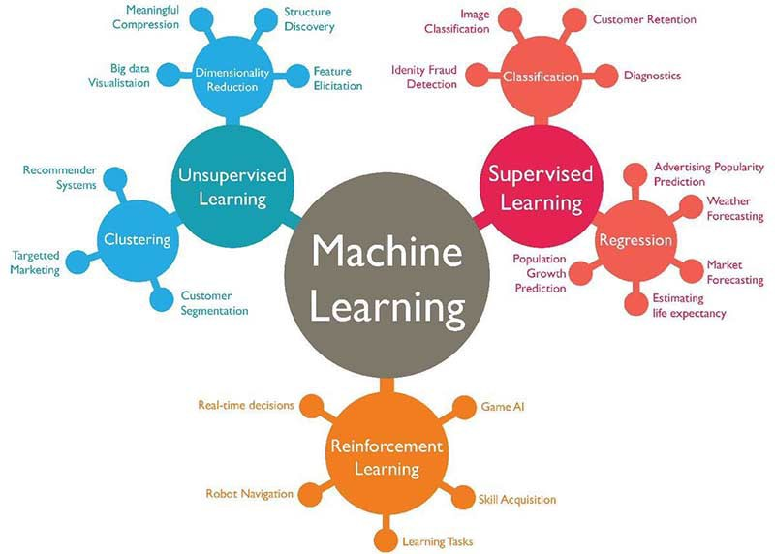
https://towardsdatascience.com/introduction-to-machine-learning-for-beginners-eed6024fdb08

Slide 56
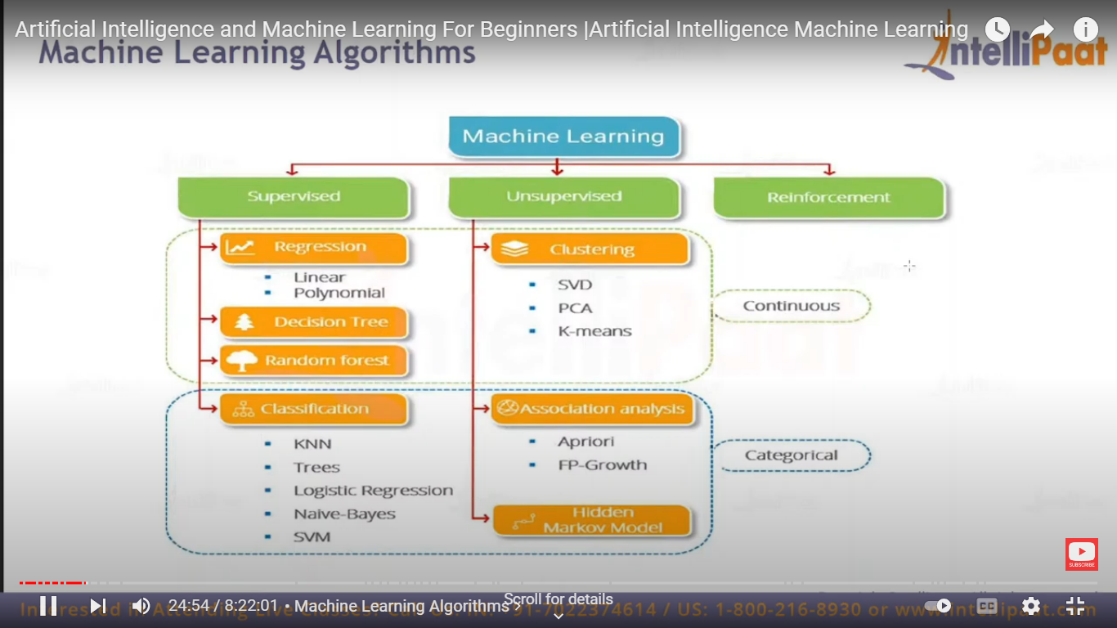

Slide 57
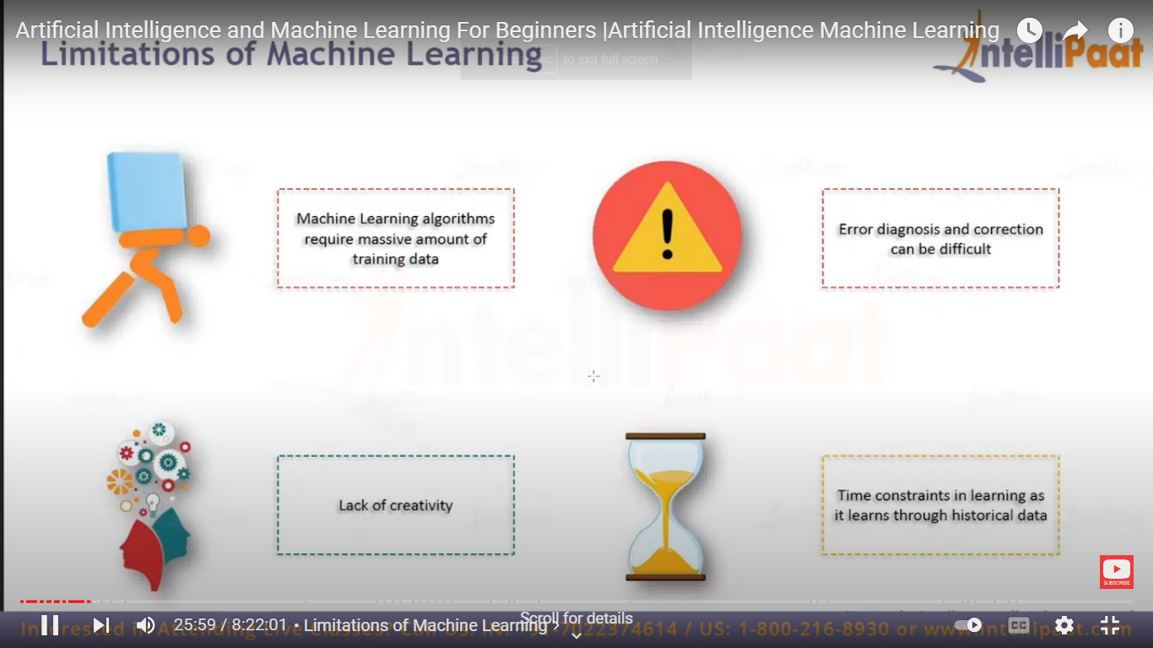
Limitation of ML
https://www.youtube.com/watch?v=PoTarJp7Pxk

Slide 58
APPLICATIONS OF MACHINE LEARNING
Banking and finance(fraudulent transactions- credit card), Insurance, healthcare.
Virtual Personal Assistants
Siri, Alexa, Google Now
Predictions while Commuting(moving):
Traffic Predictions, online transportation networks(booking cabs- estimate the cost )
Videos Surveillance:
to detect crime before they happen. They track unusual behaviour of people like standing motionless for a long time, stumbling, or napping on benches etc.
Social Media Services:
People You May Know – FB, Face Recognition
Email Spam and Malware Filtering
Search Engine Result Refining
Product Recommendations

Slide 59
LANGUAGES/TOOLS IN MACHINE LEARNING:
Python:
Python has very strong libraries for advanced mathematical functionalities (NumPy), algorithms and mathematical tools (SciPy) and numerical plotting (matplotlib).
Built on these libraries, there is a machine learning library named scikitlearn, which has various classification, regression, and clustering algorithms embedded in it.

Slide 60
Best python IDEs
Pycharm
Kite
Spyder
IDLE(Integrated Development and Learning Environment)
Subkime text3
VS code
Atom
Jupyter
PyDev
Thonny

Slide 61
R:
R is a language for statistical computing and data analysis. It is an open source language, extremely popular in the academic community – especially among statisticians and data miners.
R is a very simple programming language with a huge set of libraries available for different stages of machine learning.
Matlab:
MATLAB (matrix laboratory) is a licenced commercial software with a robust support for a wide range of numerical computing. MATLAB has a huge user base across industry and academia. MATLAB is developed by MathWorks, a company founded in 1984.
SAS:
SAS (earlier known as ‘Statistical Analysis System’) is another licenced commercial software which provides strong support for machine learning functionalities. Developed in C by SAS Institute, SAS had its first release in the year 1976

Slide 62
Preparing to Model
How to understand the incoming data and create basic understanding about the nature(characteristics) and quality of the data.
MACHINE LEARNING ACTIVITIES :
The first step in machine learning activity starts with data.
In case of supervised learning, it is the labelled training data set followed by test data which is not labelled.
In case of unsupervised learning, there is no question of labelled data but the task is to find patterns in the input data

Slide 63
Typical preparation activities to be done once the input data comes into the machine learning system:
Understand the type of data in the given input data set.
Explore the data to understand the nature and quality.
Explore the relationships amongst the data elements, e.g. inter-feature relationship.
Find potential issues in data.
Do the necessary remediation, e.g. impute missing data values, etc., if needed.
Apply pre-processing steps, as necessary.
Data preparation tasks include data collection, cleansing, aggregation, augmentation, labeling, normalization and transformation as well as any other activities for structured, unstructured and semi-structured data.
Once the data is prepared for modelling, then the learning tasks starts.
As a part of it, do the following activities:
The input data is first divided into parts – the training data and the test data (called holdout). This step is applicable for supervised learning only.
Consider different models or learning algorithms for selection.
Train the model based on the training data for supervised learning problem and apply to unknown data. Directly apply the chosen unsupervised model on the input data for unsupervised learning problem.

Slide 64
Procedures during the data preparation, collection and cleansing process include the following:
Collect data from the various sources.
Standardize formats across different data sources.
Replace incorrect data.
Enhance and augment data.
Add more dimensions with pre-calculated amounts and
"Multiply" image-based data sets if they aren't sufficient enough for training.
Remove extraneous information and duplication.
Remove irrelevant data from training to improve results.
Reduce noise reduction and remove ambiguity.
Consider anonymizing data.
Normalize or standardize data to get it into formatted ranges.
Sample data from large data sets.
Select features that identify the most important dimensions and, if necessary, reduce dimensions using a variety of techniques.
Split data into training, test and validation sets.

Slide 65
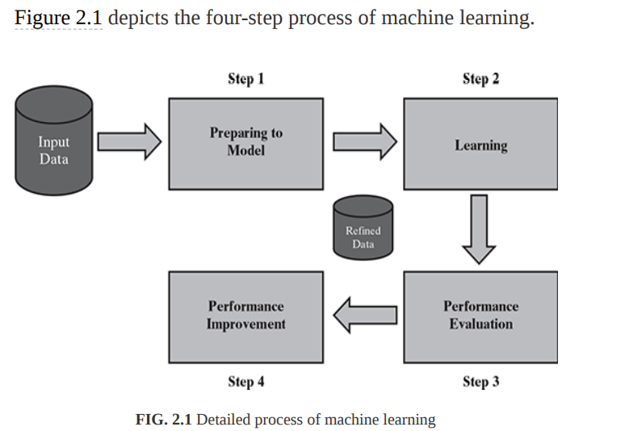
After the model is selected, trained (for supervised learning), and applied on input data, the performance of the model is evaluated.
Based on options available, specific actions can be taken to improve the performance of the model, if possible.

Slide 66
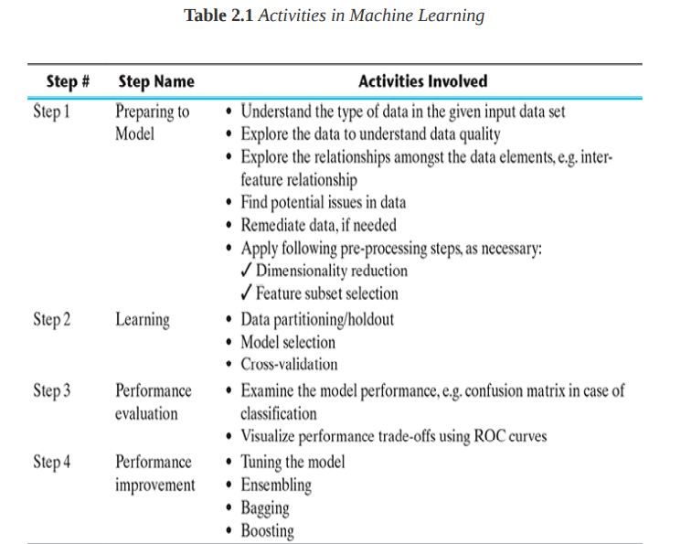

Slide 67
BASIC TYPES OF DATA IN MACHINE LEARNING
Dataset
Records and attributes:
Each row of a data set is called a record
Features/ characteristics of the records- attributes
Ex:
student : Roll Number, Name, Gender, and Age as attributes.
Attributes can also be termed as feature, variable, dimension or field

Slide 68
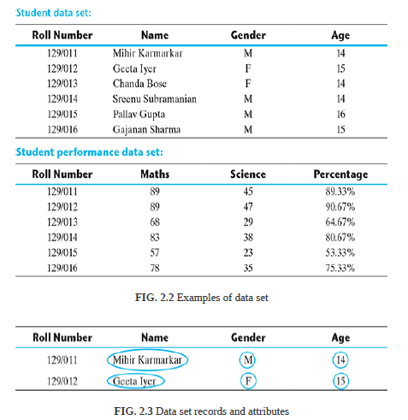

Slide 69
To understand the different types of data that we generally come across in machine learning problems. Data can broadly be divided into following two types:
1. Qualitative data (categorical)
2. Quantitative data ( Numerical)
Qualitative data provides information about the quality of an object or information which cannot be measured.
For example, quality of performance of students - Good’, ‘Average’, and ‘Poor’, it falls under the category of qualitative data.
Also, name or roll number of students are information that cannot be measured using some scale of measurement.
So they would fall under qualitative data.
Qualitative data can be further subdivided into two types as follows:
1. Nominal data
2. Ordinal data

Slide 70
Nominal data is one which has no numeric value, but a named value.
1.Blood group: A, B, O, AB, etc.
2. Nationality: Indian, American, British, etc.
3. Gender: Male, Female, Other
It is obvious, mathematical operations such as addition, subtraction, multiplication, etc. cannot be performed on nominal data.
special case of nominal data is when only two labels are possible, e.g. pass/fail as a result of an examination.
But a basic count is possible. So mode, i.e. most frequently occurring value, can be identified for nominal data.
This sub-type of nominal data is called ‘dichotomous’.

Slide 71
Ordinal data, in addition to possessing the properties of nominal data, can also be naturally ordered/ranked. This means ordinal data also assigns named values to attributes but unlike nominal data, they can be arranged in a sequence of increasing or decreasing value so that we can say whether a value is better than or greater than another value.
Examples of ordinal data are
1. Customer satisfaction: ‘Very Happy’, ‘Happy’, ‘Unhappy’, etc.
2. Grades: A, B, C, etc.
3. Hardness of Metal: ‘Very Hard’, ‘Hard’, ‘Soft’, etc.
Basic counting is possible for ordinal data.
Hence, the mode , median can be identified.
Mean can still not be calculated.

Slide 72
Quantitative data relates to information about the quantity of an object – hence it can be measured.
For example, if we consider the attribute ‘marks’, it can be measured using a scale of measurement.
There are two types of quantitative data:
1. Interval data
2. Ratio data

Slide 73
Interval data is numeric data for which not only the order is known, but the exact difference between values is also known.
An ideal example of interval data is Celsius temperature.
Other examples include date, time, shoe size etc.
For interval data, mathematical operations such as addition and subtraction are possible.
For that reason, for interval data, the central tendency can be measured by mean, median, or mode. Standard deviation can also be calculated.
interval data do not have something called a ‘true zero’ value. For example, there is nothing called ‘0 temperature’ or ‘no temperature’.
Central tendency is defined as “the statistical measure that identifies a single value as representative of an entire distribution.

Slide 74
Ratio data represents numeric data for which exact value can be measured.
Absolute zero is available for ratio data. Also, these variables can be added, subtracted, multiplied, or divided.
The central tendency can be measured by mean, median, or mode and methods of dispersion such as standard deviation.
Examples of ratio data include height, weight, age, salary, etc.

Slide 75
Apart from the approach detailed above, attributes can also be categorized into types based on a number of values that can be assigned.
The attributes can be either discrete or continuous based on this factor.
Discrete attributes can assume a finite or countably infinite number of values.
Nominal attributes such as roll number, street number, pin code, etc. can have a finite number of values
whereas numeric attributes such as count, rank of students, etc. can have countably infinite values.
A special type of discrete attribute which can assume two values only is called binary attribute.
Examples of binary attribute include male/ female, positive/negative, yes/no, etc.
Continuous attributes can assume any possible value which is a real number. Examples of continuous attribute include length, height, weight, price, etc.
In general, nominal and ordinal attributes are discrete. On the other hand, interval and ratio attributes are continuous, barring a few exceptions, e.g. ‘count’ attribute.

Slide 76
In ML, two basic data types – numeric and categorical.
to understand that in a data set, which of the attributes are numeric and which are categorical in nature.
This is because, the approach of exploring numeric data is different than the approach of exploring categorical data.

Slide 77
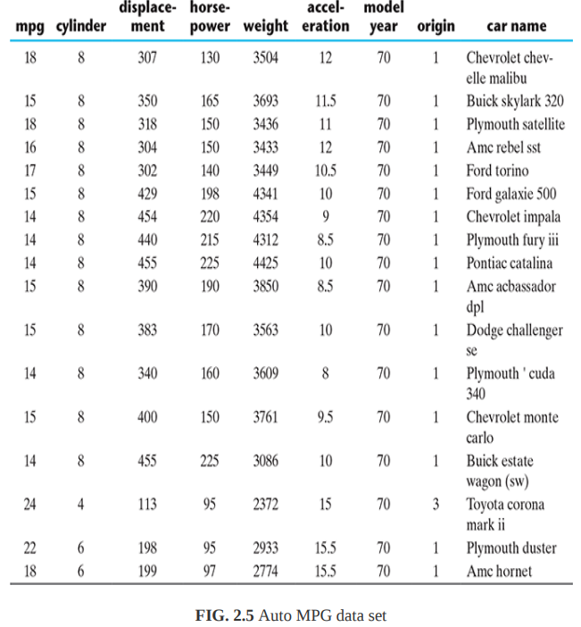

Slide 78
As is quite evident from the data, the attributes such as ‘mpg’, ‘cylinders’, ‘displacement’, ‘horsepower’, ‘weight’, ‘acceleration’, ‘model year’, and ‘origin’ are all numeric.
Out of these attributes, ‘cylinders’, ‘model year’, and ‘origin’ are discrete in nature as the only finite number of values can be assumed by these attributes.
The remaining of the numeric attributes, i.e. ‘mpg’, ‘displacement’, ‘horsepower’, ‘weight’, and ‘acceleration’ can assume any real value.
Hence, these attributes are continuous in nature. The only remaining attribute ‘car name’ is of type categorical, or more specifically nominal.
This data set is regarding prediction of fuel consumption in miles per gallon, i.e. the numeric attribute ‘mpg’ is the target attribute.
Since the attributes ‘cylinders’ or ‘origin’ have a small number of possible values, one may prefer to treat it as a categorical or qualitative attribute and explore in that way.

Slide 79
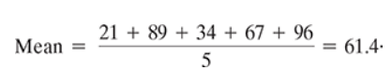
Exploring numerical data
There are two most effective mathematical plots to explore numerical data – box plot and histogram.
Understanding central tendency:
To understand the nature of numeric variables, we can apply the measures of central tendency of data, i.e. mean and median. In statistics, measures of central tendency help us understand the central point of a set of data.
Mean(average), by definition, is a sum of all data values divided by the count of data elements.

Slide 80
Median, on contrary, is the value of the element appearing in the middle of an ordered list of data elements.
If we consider the 5 ordered list of data elements– 21, 34, 67, 89, and 96. Since there are 5 data elements, the 3rd element in the ordered list is considered as the median. Hence, the median value of this set of data is 67.
For even: (simple average of the middle two numbers)
An outlier is a data point that is noticeably different from the rest. They represent errors in measurement, bad data collection, or simply show variables not considered when collecting the data.
If we observe that for certain attributes the deviation between values of mean and median are quite high, we should investigate those attributes further and try to find out the root cause along with the need for remediation.

Slide 81
In Auto MPG data set,
To find out for each of the numeric attributes the values of mean and median. We can also find out if the deviation between these values is large.
We can see that for the attributes such as ‘mpg’, ‘weight’, ‘acceleration’, and ‘model.year’ the deviation between mean and median is not significant which means the chance of these attributes having too many outlier values is less.
However, the deviation is major for the attributes ‘cylinders’, ‘displacement’ and ‘origin’.
So, we need to further drill down and look at some more statistics for these attributes. Also, there is some problem in the values of the attribute ‘horsepower’ because of which the mean and median calculation is not possible.

Slide 82
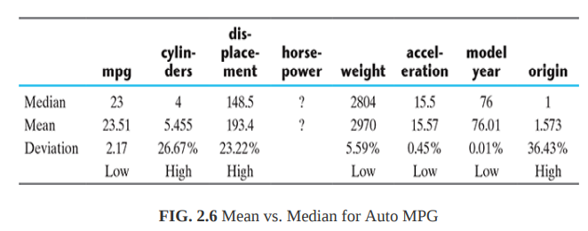
do not have value for the attribute ‘horsepower’
For that reason, the attribute ‘horsepower’ is not treated as a numeric. That’s why the operations applicable on numeric variables, like mean or median, are failing.
Some remediation of missing values (later)
Measures of Central Tendency provide a summary measure that attempts to describe a whole set of data with a single value that represents the middle or centre of its distribution

Slide 83
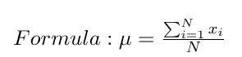
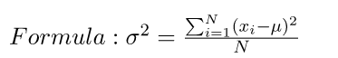
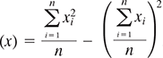
Mode :
Mode is the number which occur most often in the data set.
Mean is average of a given set of data. Let us consider below example
These eight data points have the mean (average) of 5:
here μ is mean and x₁, x₂, x₃…., x_{i} are elements.Also note that mean is sometimes denoted by
Variance is the sum of squares of differences between all numbers and means. Deviation for above example. First, calculate the deviations of each data point from the mean, and square the result of each:
Where μ is Mean, N is the total number of elements or frequency of distribution.
Standard Deviation is square root of variance. It is a measure of the extent to which data varies from the mean.

Slide 84
Understanding data spread:
we have explored the central tendency of the different numeric attributes,.
we have a clear idea of which attributes have a large deviation between mean and median.
Take a granular view of the data spread in the form of
1. Dispersion of data
2. Position of the different data values
Consider the data values of two attributes
1. Attribute 1 values : 44, 46, 48, 45, and 47
2. Attribute 2 values : 34, 46, 59, 39, and 52
Both the set of values have a mean and median of 46.
Attr1 is more clustered
Attr2 is spreaded or dispersed.
To measure the extent of dispersion of a data, or to find out how much the different values of a data are spread out, the variance of the data is measured.
Larger value of variance or standard deviation indicates more dispersion in the data and vice versa

Slide 85
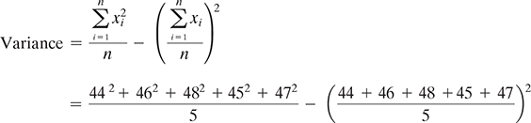
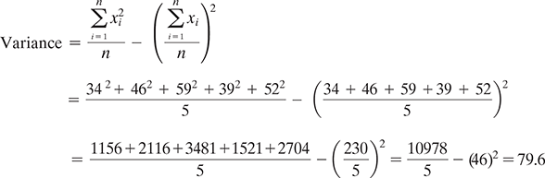
For attribute 1,
For attribute 2,

Slide 86
Measuring data value position:
When the data values of an attribute are arranged in an increasing order, we have seen earlier that median gives the central data value, which divides the entire data set into two halves.
Similarly, if the first half of the data is divided into two halves so that each half consists of one-quarter of the data set, then that median of the first half is known as first quartile or Q1 .
In the same way, if the second half of the data is divided into two halves, then that median of the second half is known as third quartile or Q3 . The overall median is also known as second quartile or Q2 .
So, any data set has five values - minimum, first quartile (Q1), median (Q2), third quartile (Q3),and maximum.
Quantiles refer to specific points in a data set which divide the data set into equal parts or equally sized quantities.
There are specific variants of quantile, the one dividing data set into four parts being termed as quartile. Another such popular variant is percentile, which divides the data set into 100 parts. Quintile :into 5

Slide 87
we still cannot ascertain whether there is any
outlier present in the data.
For that, we can better adopt some means to visualize the data.
Box plot is an excellent visualization medium for numeric data.

Slide 88
Plotting and exploring numerical data
Box plots:
Have fairly clear understanding of the data set attributes in terms of spread and central tendency.
The box plot (also called box and whisker plot) gives a standard visualization of the five-number summary statistics of a data, namely minimum, first quartile (Q1), median (Q2), third quartile (Q3), and maximum.

Slide 89
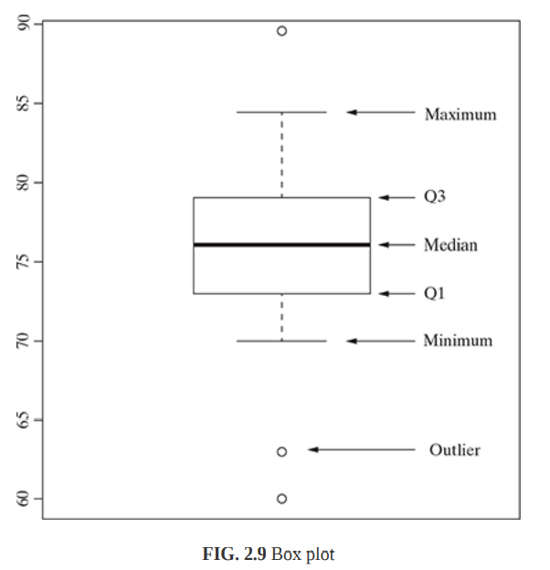

Slide 90
Histogram
Histogram is another plot which helps in effective visualization of numeric attributes.
It helps in understanding the distribution of a numeric data into series of intervals, also termed as ‘bins’.
The important difference between histogram and box plot is
The focus of histogram is to plot ranges of data values (acting as ‘bins’), the number of data elements in each range will depend on the data distribution. Based on that, the size of each bar corresponding to the different ranges will vary.
The focus of box plot is to divide the data elements in a data set into four equal portions, such that each portion contains an equal number of data elements.
Histograms might be of different shapes depending on the nature of the data, e.g. skewness.

Slide 91
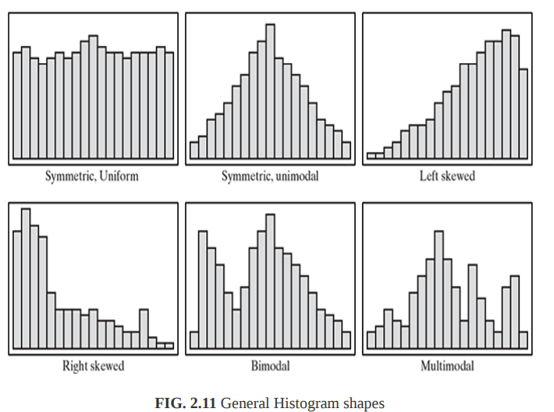

Slide 92
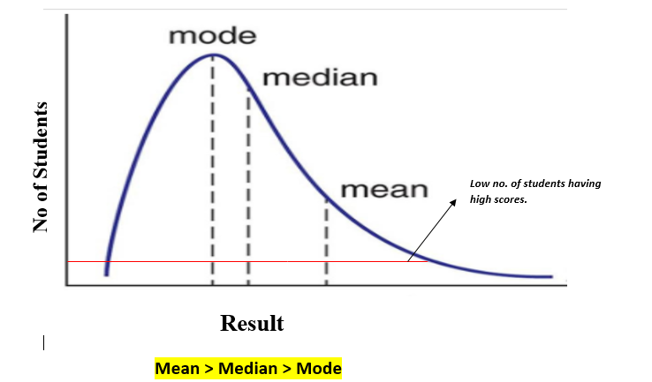

Slide 93
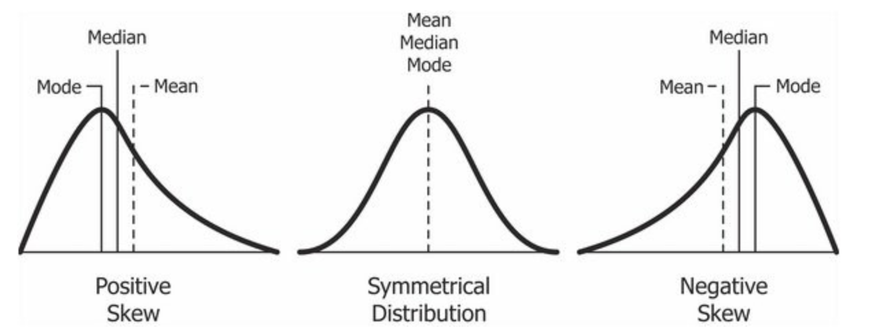

Slide 94
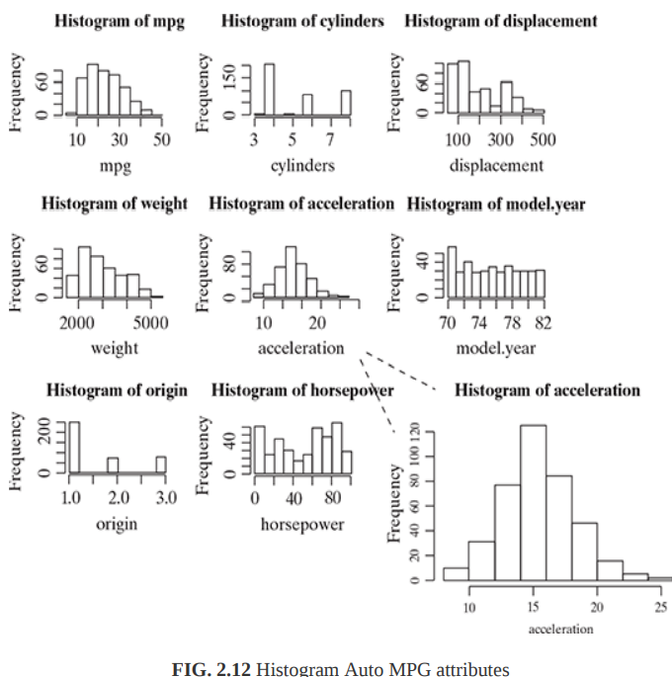

Slide 95
Exploring categorical data
We have seen there are multiple ways to explore numeric data.
Exploring categorical:
In the Auto MPG data set, attribute ‘car.name’ is categorical in nature.
Also, may consider ‘cylinders’ as a categorical variable instead of a numeric variable.
First, finding how many unique names are there for the attribute ‘car name’ and ‘cylinders’ attributes

Slide 96
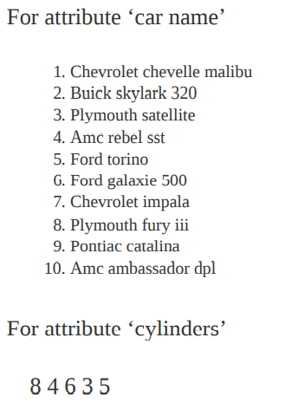

Slide 97
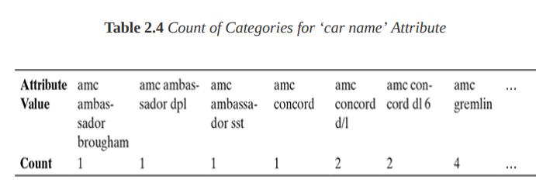
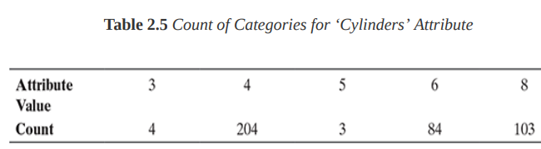
look for a little more details and want to get a table consisting the categories of the attribute and count of the data elements falling into that category

Slide 98
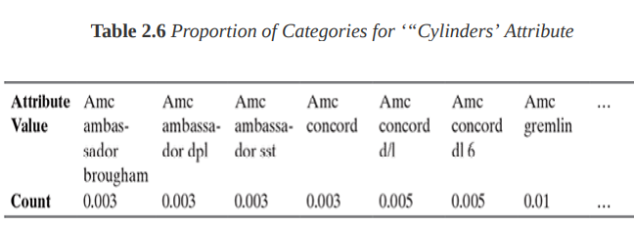
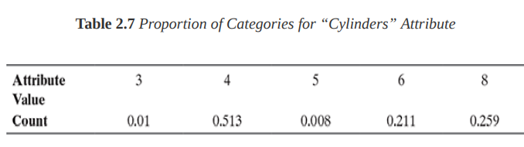
In the same way, we may also be interested to know the proportion (or percentage) of count of data elements belonging to a category.
Say, e.g., for the attributes ‘cylinders’, the proportion of data elements belonging to the category 4 is 204 ÷ 398 = 0.513, i.e. 51.3%.

Slide 99
Mode of a data is the data value which appears most often.
In context of categorical attribute, it is the category which has highest number of data values.
Since mean and median cannot be applied for categorical variables, mode is the sole measure of central tendency.
An attribute may have one or more modes.
Frequency distribution of an attribute having single mode is called ‘unimodal’.
two modes are called ‘bimodal’
multiple modes are called ‘multimodal’.

Slide 100
Exploring relationship between variable
One more important angle of data exploration is to explore relationship between attributes.
There are multiple plots to enable us explore the relationship between variables.
The basic and most commonly used plot is scatter plot.
A scatter plot helps in visualizing bivariate relationships, i.e. relationship between two variables.
It is a two-dimensional plot in which points or dots are drawn on coordinates provided by values of the attributes.
For example, in a data set there are two attributes – attr_1 and attr_2.
To understand the relationship between two attributes, i.e. with a change in value of one attribute, say attr_1, how does the value of the other attribute, say attr_2, changes. draw a scatter plot, with attr_1 mapped to x-axis and attr_2 mapped in y-axis.
As in a twodimensional plot, attr_1 is said to be the independent variable and attr_2 as the dependent variable.

Slide 101
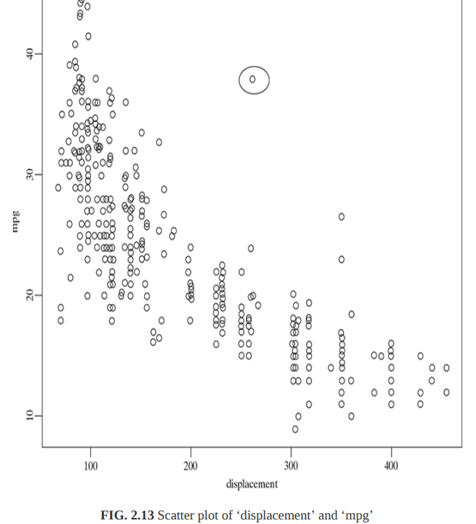

Slide 102
As is evident in the scatter plot, there is a definite relation between the two variables.
The value of ‘mpg’ seems to steadily decrease with the increase in the value of ‘displacement’.
It may come in our mind that what is the extent of relationship?
Well, it can be reviewed by calculating the correlation between the variables.
One more interesting fact to notice is that there are certain data values which stand-out of the others.
This gives an indication that of presence of outlier data values.

Slide 103


Slide 104

Two-way cross-tabulations
Two-way cross-tabulations (also called cross-tab or contingency table) are used to understand the relationship of two categorical attributes in a concise way.
It has a matrix format that presents a summarized view of the bivariate frequency distribution.
A cross-tab, very much like a scatter plot, helps to understand how much the data values of one attribute changes with the change in data values of another attribute.

Slide 105
Relationship between Numerical Variables
Many machine learning algorithms require that the continuous variables not be correlated with each other, a phenomenon called multicollinearity. Establishing relationships between the numerical variables is a common step to detect and treat multicollinearity.
Correlation Matrix

Slide 106
Correlation Matrix
Creating a correlation matrix is a technique to identify multicollinearity among numerical variables.
This can be created using the corr() function.
dat.corr()
Correlation Plot
The correlation can also be visualized using a correlation plot, which is implemented using the pairplot function in the seaborn package.

Slide 107


Slide 108


Slide 109
Correlation Test
A correlation test is another method to determine the presence and extent of a linear relationship between two quantitative variables.
In our case, we would like to statistically test whether there is a correlation between the applicant’s investment and their work experience.
The first step is to visualize the relationship with a scatter plot.
plt.scatter(dat['work_exp'], dat['Investment'])
plt.show()

Slide 110


Slide 111

quantify this inference by calculating the correlation coefficient.
np.corrcoef(dat['work_exp'], dat['Investment']).
The value of 0.07 shows a positive but weak linear relationship between the two variables.

Slide 112

Relationship Between Categorical Variables
In the previous sections, we covered techniques of finding relationships between numerical variables. It is equally important to understand and estimate the relationship between categorical variables.
Frequency Table
A frequency table is a simple but effective way of finding distribution between two categorical variables. The crosstab() function can be used to create the two-way table between two variables. In the line of code below, we create a two-way table between the variables marital_status and loan_approval.
1pd.crosstab(dat.Marital_status, dat.approval_status)

Slide 113

Chi-square Test of Independence
The chi-square test of independence is used to determine whether there is an association between two or more categorical variables. In our case, we would like to test whether the marital status of the applicants has any association with their approval status.
This can be easily done in Python using the chi2_contingency() function from the scipy.stats module. The lines of code below perform the test.
1from scipy.stats import chi2_contingency 2chi2_contingency(pd.crosstab(dat.Marital_status, dat.approval_status))python
Output:

Slide 114
Value of standard deviation is 0 if all entries in input are same.
If we add (or subtract) a number say 7 to all values in the input set, the mean is increased (or decreased) by 7, but the standard deviation doesn’t change.
If we multiply all values in the input set by a number 7, both mean and the standard deviation is multiplied by 7. But if we multiply all input values with a negative number say -7, the mean is multiplied by -7, but the standard deviation is multiplied by 7.
Standard deviation and variance is a measure that tells how spread out the numbers is. While variance gives you a rough idea of spread, the standard deviation is more concrete, giving you exact distances from the mean.
Mean, median and mode are the measure of central tendency of data (either grouped or ungrouped).
https://www.geeksforgeeks.org/mathematics-mean-variance-and-standard-deviation/#:~:text=Standard%20deviation%20and%20variance%20is,(either%20grouped%20or%20ungrouped).
https://medium.com/analytics-vidhya/statistics-mean-median-mode-variance-standard-deviation-47fab926465a

Slide 115



Slide 119
1956, AI term has been coined (John McCarthy together with Alan Turing, Marvin Minsky, Allen Newell, and Herbert A. Simon.). The concept is very old but recently it got its popularity.
The Reason is that earlier we have only small amount of data . The data we have was not enough to predict the accurate data.
But now a days , there is a tremendous increase in the amount of data . Still it going to increase in its amount to yotabytes.
We are having advanced algorithms, high end computing power and storage to deal with such large amt of data. As a result 90% of enterprise will implement AI.
ML will came into existence in the late 80s and early 90s.
Issues with people that make ML to come into existence.
In the field of statistics, how to efficiently train large complex model.
In the field of CS and AI, how to train more robust version of AI system.
In neuroscience, how to design the operatoin model of brain
Which enable the computer to act and make data driven decisions to carryout certain task.
These programs or algorithms are designed in a way that they can learn and improve over time when exposed to new data.

Slide 121
DL:
Concept is not new but recently it got its more attention.
Subset of ML(next evolution of ML) and based/inspired on the functionality of our brain cells called neurons.
No one knows what happens inside the neural networks and why it works so well (or call it as a black box)
Example :
To identify, whether the given image is dog or cat?
With ML:
First ,we define the features of that animal like
Whether having whiskers or not
Pointed ears or not
Tail is straight or curved
Then let the system identify which features are more important in classifying a particular animal.
Now , in DL, it find outs the feature which are most important for classification, in ML we have to manually give out those features.

Slide 122
Data dependencies:
Performance as the volume of data gets increased.
ML: works on small amount of data
DL works well on large amount of data
Hardware dependency:
DL heavily dependent of high end machines (GPUs)but ML can work on Low end machines also
Feature Engineering: feature needs to be identified manually in ML but in DL, it will learn high level features

Slide 123
What is machine learning?
Machine learning is a branch of artificial intelligence (AI) and computer science which focuses on the use of data and algorithms to imitate the way that humans learn, gradually improving its accuracy.
Machine learning is an important component of the growing field of data science. Through the use of statistical methods, algorithms are trained to make classifications or predictions, uncovering key insights within data mining projects. These insights subsequently drive decision making within applications and businesses, ideally impacting key growth metrics. As big data continues to expand and grow, the market demand for data scientists will increase, requiring them to assist in the identification of the most relevant business questions and subsequently the data to answer them.

Slide 124
Machine Learning vs. Deep Learning vs. Neural Networks
Machine learning, deep learning, and neural networks are all sub-fields of artificial intelligence. However, deep learning is actually a sub-field of machine learning, and neural networks is a sub-field of deep learning.
The way in which deep learning and machine learning differ is in how each algorithm learns. Deep learning automates much of the feature extraction piece of the process, eliminating some of the manual human intervention required and enabling the use of larger data sets. You can think of deep learning as "scalable machine learning" as Lex Fridman notes in this MIT lecture.
Classical, or "non-deep", machine learning is more dependent on human intervention to learn. Human experts determine the set of features to understand the differences between data inputs, usually requiring more structured data to learn.

Slide 125
"Deep" machine learning can leverage labeled datasets, also known as supervised learning, to inform its algorithm, but it doesn’t necessarily require a labeled dataset. It can ingest unstructured data in its raw form (e.g. text, images), and it can automatically determine the set of features which distinguish different categories of data from one another. Unlike machine learning, it doesn't require human intervention to process data, allowing us to scale machine learning in more interesting ways. Deep learning and neural networks are primarily credited with accelerating progress in areas, such as computer vision, natural language processing, and speech recognition.

Slide 126
Neural networks, or artificial neural networks (ANNs), are comprised of a node layers, containing an input layer, one or more hidden layers, and an output layer. Each node, or artificial neuron, connects to another and has an associated weight and threshold. If the output of any individual node is above the specified threshold value, that node is activated, sending data to the next layer of the network. Otherwise, no data is passed along to the next layer of the network. The “deep” in deep learning is just referring to the depth of layers in a neural network. A neural network that consists of more than three layers—which would be inclusive of the inputs and the output—can be considered a deep learning algorithm or a deep neural network. A neural network that only has two or three layers is just a basic neural network.
https://www.ibm.com/cloud/learn/machine-learning

Slide 127
Google colab
Colaboratory, or “Colab” for short, is a product from Google Research. Colab allows anybody to write and execute arbitrary python code through the browser, and is especially well suited to machine learning, data analysis and education.
Colaboratory is a free Jupyter notebook environment that requires no setup and runs entirely in the cloud
Google Colaboratory or Google Colab is a free Jupyter Notebook environment(web based interactive computing platform). It is a free cloud-based service by Google which means you don't have to pay anything. One of the best things about Colab is that you don't need to install anything beforehand.

Slide 128
Kaggle allows users to find and publish data sets, explore and build models in a web-based data-science environment, work with other data scientists and machine learning engineers, and enter competitions to solve data science challenges.
Why does everyone use Kaggle?
Like Medium, GitHub, Stack Overflow, and LinkedIn, Kaggle serves as a community where data analysts, data scientists, and machine learning engineers can come to learn, grow, and network. You can post your work (data, code, and notebooks) that can be ultimately shared to grow your own community

Slide 129
What is difference between Python IDLE and Anaconda?
The main difference between Anaconda and Python is, Anaconda is a distribution of Python and R programming languages for data science and Machine learning tasks whereas Python is a high-level general-purpose programming language whereas. The package manager in Anaconda is called Conda while for the Python it is pip.

Slide 130
Python IDLE
IDLE is Python’s Integrated Development and Learning Environment.
IDLE has the following features:
cross-platform: works mostly the same on Windows, Unix, and macOS
Python shell window (interactive interpreter) with colorizing of code input, output, and error messages
multi-window text editor with multiple undo, Python colorizing, smart indent, call tips, auto completion, and other features.
Steps to Download and Install Python 3.9 on Windows and how to run python program

Slide 131
Python has two basic modes: script and interactive.
The normal mode is the mode where the scripted and finished .py files are run in the Python interpreter.
Interactive mode is a command line shell which gives immediate feedback for each statement, while running previously fed statements in active memory.

Slide 132


Slide 133


Slide 134
Google colaboratory
Colaboratory, or “Colab” for short, is a product from Google Research. Colab allows anybody to write and execute python code through the browser, and is especially well suited to machine learning, data analysis and education.
Google Colaboratory is a free online cloud-based Jupyter notebook environment that allows us to train our machine learning and deep learning models.
It does not matter which computer you have, what it's configuration is, and how ancient it might be.

